Slide 1
Starting Out With JUnit 5
JavaOne 2017 Hands On Lab
Barry Evans
(With slides from Jeanne Boyarsky)
March 23rd, 2018
Twitter @bazza_ni

Slide 2
About Me
11 years as
Java Developer
JUnit user
💚 Clean Code & TDD
💔 Bugs & Untested Code
@bazza_ni

Slide 3
Why JUnit 5?
Java 8 support!
More annotations/assertions!
More power!
Released September 10th, 2017

Slide 4






Supports
Not Yet
Note: Eclipse requires update to Oxygen until JUnit 5 released
Notes:
Image sources:
https://commons.wikimedia.org/wiki/File:Antu_netbeans-ide.svg
https://commons.wikimedia.org/wiki/File:Eclipse-SVG.svg
https://commons.wikimedia.org/wiki/File:IntelliJ_IDEA_Logo.svg
https://ant.apache.org
https://maven.apache.org

Slide 5
What you’ll learn in the lab
How to convert a Maven project
New jars
Required config
Changes from JUnit 4
New functionality

Slide 6
Flow
The lab is self paced
Raise your hand if you get stuck or have a question.
If there is a FAQ, I’ll demo it on the screen.
Recommend to use a git commit after each section

Slide 7
What tools do I use?
Eclipse
or
IntelliJ
or
Command line Maven/Git
+ your choice of text editor

Slide 8
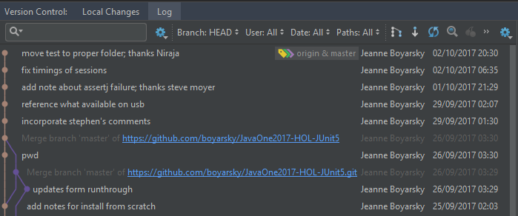
Before…

Slide 9
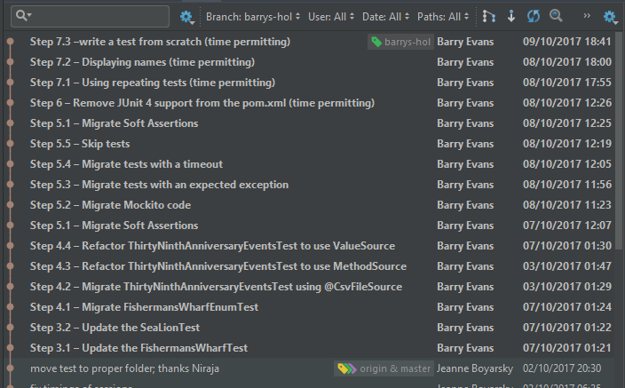
After…

Slide 10

Let’s start!
On to the lab!
In a browser go to
https://github.com/bazzani/JavaOne2017-HOL-JUnit5
Open JUnit 5 HOL Instructions.docx word doc
Notes:
https://pixabay.com/p-154544/?no_redirect

